Slide 1
Exercises
Analysis of protein stretching experiments

Slide 2
Preparations
Create a working folder on your computer
For experimenting
Create a separate folder for the Matlab files
Download files to this folder from GitHub:
https://github.com/are-mj/OpticalTweezers
cd to the working folder
Add the Matlab files folder to the Matlab path
addpath <folder path>

Slide 3
Experiment files
Download the experiment files to a folder on your computer
Alternatively, the files may be accessible on a network disk
In Matlab:
Open datafolder.m and modify it so that folder = <data folder>

Slide 4
Files to use in exercises
Alternatives
Use result files from your experiments.
Use a set of earlier files
Extract files from
OpticalTweezers/Summer school 2024/Testfiles.zip

Slide 5
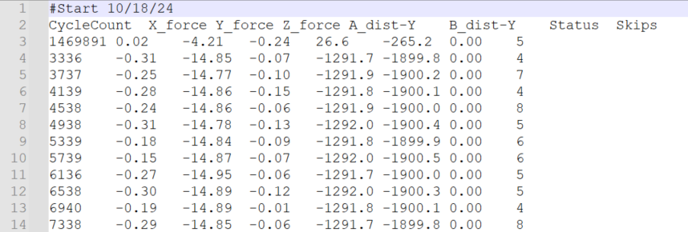
Experiment data file
Skip first record
seconds*4000
Use mean of trap positions A and B
(minus) Force (pN)
(minus) Trap pos. A
(minus) Trap pos. B
Temperature code

Slide 6
Reading an experiment file
[t,f,x,T] = read_experiment_file(file);
Inputs:
file: aA.txt, folder1/Aa.txt or full path
Outputs:
t: Time (seconds since experiment start)
f: Pulling force (pN)
x: Trap position (nm)
T: Temperature (˚C)

Slide 7
Exercise 1 A: Finding rips and zips
Use read_experiment_file to read one file
Create plots of f(t) and x(t) as subplots in the same figure:
figure; tiledlayout;
ax1 = nexttile; plot(t,f); xlabel s; ylabel pN
ax2 = nexttile; plot(t,x); xlabel s; ylabel nm
linkaxes([ax1,ax2],'x’) % Couple zoom and pan in both axes
Try to locate the first few rips and zips
Note the approximate times and force values

Slide 8
Exercise 1 B
Run analyse_experiment for the same experiment file
Make sure to set input ‘plotting’ to 1:
[Trip,Tzip] = analyse_experiment(file,1);
Do the automatic rips and zips agree with yours?
If not, comment on who is probably right, and why.

Slide 9
Exercise 1 C Δx and force shift
Zoom to one cycle having both a rip and a zip
Create variables t1 and t2 for the times for the valley on each side
Use the datacursor tool to see the times
Create logical array ok which is true only between t1 and t2
ok = t > t1 & t < t2;
figure; plot(x(ok),f(ok))
Estimate Δx for the rip and the zip
Tip: Use the datacursor tool
Estimate the force shifts

Slide 10
Exercise 1 D Matlab tables
Find the row in Trip that corresponds to the rip that you estimated Δx and force shift for. How do your estimates compare with the values found automatically?
Possible reasons for any differences?

Slide 11
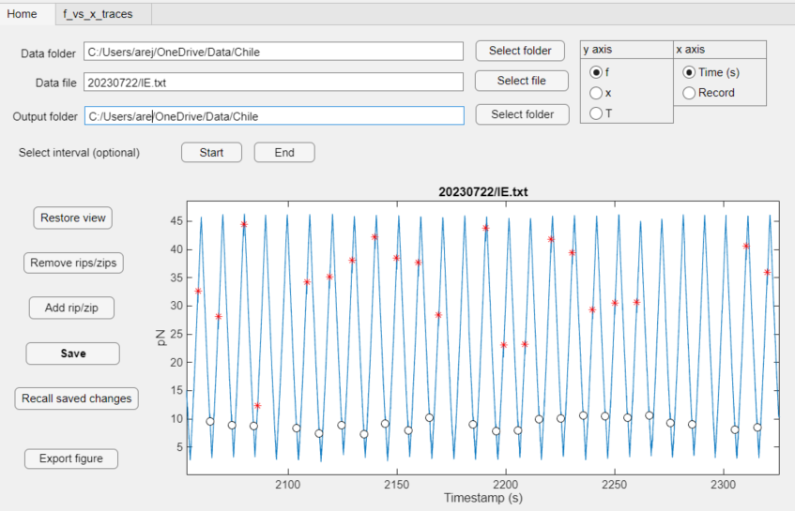
The RipAnalysis app: Home tab

Slide 12
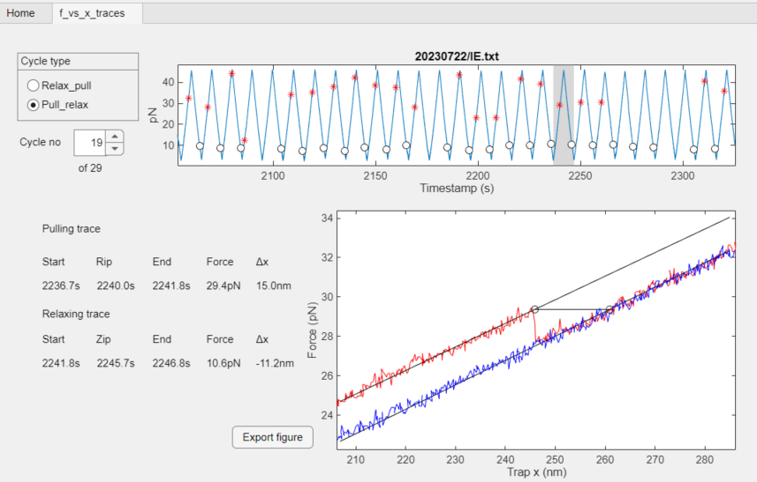
The RipAnalysis app: f(x) tab

Slide 13
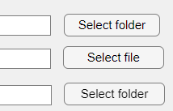
The RipAnalysis app
Start the app by right-clicking RipAnalysis.mlapp
Within Matlab: select Run
In File Explorer or equivalent: select Open
Specify folders and file
Use the buttons to browse, or paste text into the text boxes
The data file may contain subfolder name
The Output folder may be the same as the Data folder
Not recommended if you are sharing the data folder with others

Slide 14
Exerise 2: The RipAnalysis app
In this exercise we want you to use the app to go through a number of your results files
Inspect the automatically identified rip and zip events
Remove any incorrect event
Add any missing events
Store results tables Trip and Tzip
The next two slides show how to remove and add events

Slide 15
Exercise 2: Removing things
If Data folder and Data file are correct you should see a f(t) graph with rips and zips marked
Remove any disturbing data at start of end by clicking the Start or End buttons and use the crosshairs to specify new limits.
If crosshairs are very slow to react it may help to exit Matlab and start again.
To remove a rip/zip: Zoom in so that fewer than 20 rips and zips are visible. Then click the Remove rip/zip button and select one or more events to remove from the List box
Click the Save button to store Trip and Tzip tables
Notes:
Remove end: Files(1): 20230721/KC.txt Remove rip: 20230721/gA.txt (files(2))

Slide 16
Exercise 2: Adding a rip or a zip
Find an experiment with a missing rip
E.g. 20230724/qA.txt from Testfies.zip
Zoom in close to the missing rip and click Add Rip/Zip
Use the crosshairs to specify the time of the rip
Click the Save button again
Reload the original file
Mark the file name
Cut the file name (ctrl-x on Windows)
Click somewhere outside the text box to let Matlab register the change
Paste the file name back
Click “Recall saved changes”
Notes:
20230724/qA.txt . Files(5)

Slide 17
Exercise 3: Fit model to data
Workflow:
Collect all analysis result tables into TRIP and TZIP
Select the subset you want to model (e.g. Temperature > 20)
Prepare the input to fit_Bell_unfold.m
Define initial values for the parameter vector
Calculate best fit parameters for the Bell model
Check that results look ok
If not, try with other initial values
See Fitting models to experiment.pptx for details
If you still have time: Try to fit the Dudko model

Slide 18
Help needed!
The Matlab programs have a single author
Limited creativity / fantasy
Room for improvement
Probably many undetected bugs
Need new blood!
Need help with program development and maintenance!
Please contact Christian Wilson or me if you are interested.
For my Email address, type: contact_details

